Slide 1







FIELDWORK PROJECT 2025: CRM REACTIVATION
OUR TEAM:
Roberto Vanzetta
Helena Borges Daré
Ignacio Kreis
Jacopo Abete
Jasper von Pachelbel
Master Academic Year (2024/2025)

Slide 2



Reactivation of Inactive Customers can help leverage Economic Potential
OUR CUSTOMER & CHALLENGE
EXPECTED OUTCOME
The customer, a leading European company in manufacturing and sales of tools and for the building a crafting sector
Significant proportion of customers are inactive, with no purchases in the past two years
Inactive customers are unrealized economic potential for the company
Development of a reactivation prediction model which identifies customers with the highest potential of return
Providing the company with a starting point to take targeted actions for reactivation and to maximise conversion
CRM reactivation

Slide 3


Understanding CRM
CRM = Customer Relationship Management
includes all measures to build, maintain and reactivate customer relationships.
CRM Reactivation
to retarget customers which did not purchase since 2 years.
based on data analysis -> to select the customers with the highest probability of return and the highest economic potential.

Slide 4
Our Analytical Strategy follows 5 Steps
1
Data Understanding & Exploration
5
Business Insights
Understanding of columns
Analysis and handling of missing values
Translation of findings into valuable business strategies
3
Modeling
Identification of patterns for active/inactive customers
2
Feature Engineering
4
Model Evaluation
Merging Datasets
Creating new insightful variables
Technical criteria's
Choice of best model

Slide 5
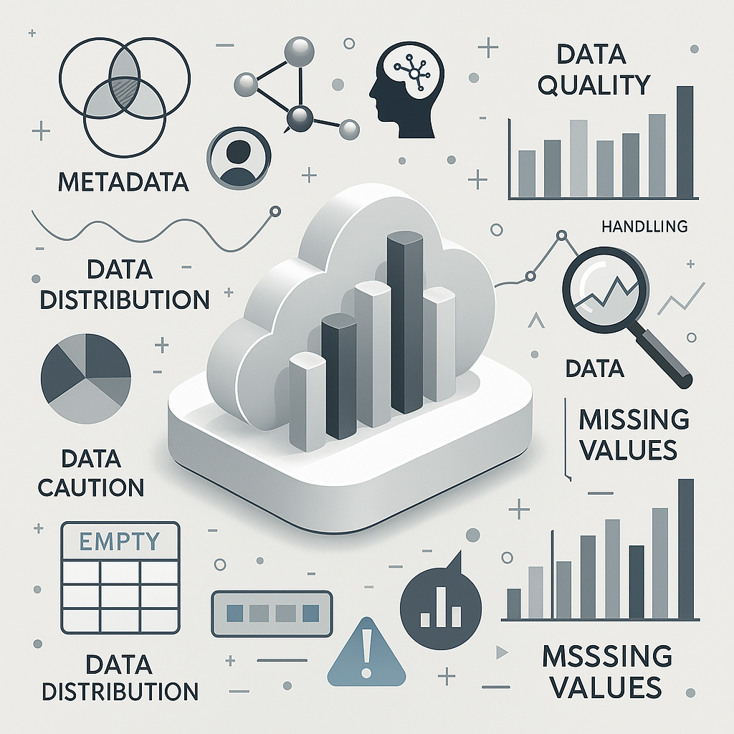

1. Data Understanding & Exploration

Slide 6



Two datasets consisting of >2 million entries provide the basis for analysis
TOOL_SALES (Sales Data 2017 – 2021)
Purchase History of customers
Allows Identification of purchasing behaviour patterns
TOOL_CLIENT (Customer Database)
Client Information
Enables Customer Segmentation
We merged the customer and sales datasets to create a unified view, and removed columns not relevant for modeling (e.g., canceled orders).

Slide 7

2. Feature Engineering

Slide 8



Creation of new features to Spot Reactivation Signals:
sales_id: Created combining client_id and yyyymm, it represents a single transaction
n_purchase: Created grouping sales_id by client_id, it represents the total number of purchases per client
sales_net: summarizing the net sales by sales_id, it shows cumulative sales value per client.
time_diff_next: Obtained extracting time between purchases, it shows the time until the next purchase. (Note: For the missing values, we assume the difference been 0 days)
These new features are expected to have a greater impact on the model, as they aggregate more general variables.

Slide 9


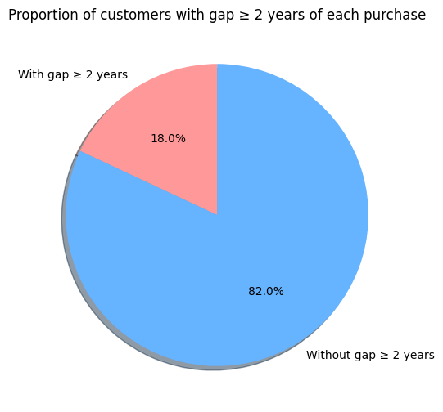
Understanding Customer Purchase Behavior
CUSTOMERS TYPE
KEY INSIGHTS
The reactivation class is underrepresented → Work on dataset or work on models.
Client purchasing behavior is heavily skewed → we considered feature scaling (RobustScaler).
Some engineered features may already show predictive power before modeling begins (n_purchases, sales_net, or region).
Notes:
Method Used: Association Rules (Apriori Algorithm)
We used a technique that’s often applied in retail: “People who buy this, also tend to buy that.”
Step-by-Step:
Grouped purchases per client.
Transformed that into a table of YES/NO (One-Hot Encoding)
Ran the Apriori Algorithm
Created rules like: "If a client buys item A and B, there’s a 90% chance they’ll also buy item C“
4. Sorted Rules by Strength
We focused on rules that are common and highly confident (they're true most of the time).

Slide 10





Creation of new Dataframe on customer base for Modeling
Now each row represents a unique client_id.
We created one row per client with aggregated features.
Creation of a target column that is 1 if they were reactivated, 0 otherwise.
Why was it necessary?
In order to have a customer based target instead of a transaction based one , since our goal is to predict a particular customer inclination to be reactivated.

Slide 11

3. Modeling
Notes:
We explored different modeling techniques: Logistic Regression, Random Forest, and XGBoost. Each has its strengths and trade-offs.”

Slide 12





Modeling technique: Logistic Regression
PRO’ S
CON’ S
Highly interpretable: Clear insights into feature impact.
Simple and fast: Easy to implement and explain.
Good baseline: Serves as a benchmark for complex models
Assumes linear relationships: Can miss complex patterns in behavior.
Lower accuracy: Often underperforms on non-linear problems.
Needs careful feature engineering: Less automatic than tree-based models.
Notes:
“We chose Logistic Regression as a baseline due to its simplicity and high interpretability. However, it assumes linear relationships, which may miss complex customer behaviors.” Less interpretable than simple models Harder to explain decisions compared to Logistic Regression — not ideal when stakeholders need clear, rule-based insights.
Slower to train and predict on large datasets Especially with many trees and features, RF can be resource-intensive.
May overfit if not properly tuned Even though RF reduces overfitting compared to single trees, it’s still possible, especially with noisy or high-cardinality data.
Feature importance can be misleading RF can overemphasize features with many categories or higher cardinality (e.g., client IDs or product codes).

Slide 13




Modeling technique: Random Forest
PRO’ S
CON’ S
Handles non-linear relationships between features → essential for modeling complex customer behavior.
Works well with mixed data types (categorical + numerical) without heavy preprocessing.
Robust to missing values and imbalanced classes like few reactivated vs. many inactive customers.
Provides feature importance insights helps business understand what drives reactivation.
Less interpretable than simple models
Slower to train and predict on large datasets
Feature importance can be misleading
Notes:
“Random Forest handles non-linear relationships, missing values, and mixed data types very well. It's also robust to class imbalance — which is key in reactivation tasks. But it's less interpretable and slower to train on large datasets.”

Slide 14


Modeling technique: XGBoost
PRO’ S
CON’ S
High accuracy: Often the best-performing model in practice.
Handles rare events well: Good for imbalanced problems like reactivation.
Flexible and tunable: You can optimize for precision, recall, etc.
Sensitive to tuning: Needs careful parameter adjustment.
Longer training time: Especially with large datasets.
Harder to explain: Less transparent than Logistic Regression.
Notes:
Less interpretable than simple models Harder to explain decisions compared to Logistic Regression — not ideal when stakeholders need clear, rule-based insights.
🐢 Slower to train and predict on large datasets Especially with many trees and features, RF can be resource-intensive.
❌ May overfit if not properly tuned Even though RF reduces overfitting compared to single trees, it’s still possible, especially with noisy or high-cardinality data.
🔍 Feature importance can be misleading RF can overemphasize features with many categories or higher cardinality (e.g., client IDs or product codes).

Slide 15



For modeling the reactivation, we aimed to choose features that:
QUALITIES
TO PREDICT THE “TARGET”
Capture meaningful behavioral patterns (how clients used to buy)
Reflect business potential (e.g., economic value of the client)
Available before reactivation (predictive, not reactive)
Are consistently available for most clients
Whether the client reactivated or not
→ binary classification
The goal was to model the propensity to return capturing
profile info
behavioral patterns

Slide 16

To capture profile info and patterns to model the propensity to return
FEATURES USED TO TRAIN MODELS
INSIGHTS
-region | → Client's market segment
-n_employees | → Size of business
-economic_pot -eco_pot_class | → Business potential
-sales_channel | → Channel/ product preferences
-net -n_purchases | → Purchase behavior
-flg_tool | → Identifies if purchase was a tool or a part
-risk_cat | → Client risk
Customers with higher number of purchases → strongest likelihood of reactivation.
Risk categories help us group customers by behavior
Sales channel and customer value → decide who to prioritize

Slide 17


For training the model we dropped the client features:
Features dropped | Reason
-item_id | → Not feasible to aggregate due to complexity
-trade_sector -sales_id | → Not informative
-family_code | → grouping already included in group_code
-client_create_date -yyyymm | → Temporal, not predictive

Slide 18

4. Model Evaluation

Slide 19



Evaluation of our 3 Models
Logistic Regression
Random Forest
XGBoost (XGB)

Slide 20
Evaluation Criteria
1
PRECISION
RECALL
F1 SCORE
2
3
How many of the selected customers actually returned.
High
We don't waste marketing budget on the wrong customers.
Low
We address a lot of “false alarms” - this costs money unnecessarily.
How many of the customers who actually returned got recognized by the model.
High
We don't miss any potential returnees.
Low We miss out on many opportunities because we don't address them at all.
The F1 score is the harmonic mean of precision and recall.
It helps us to find a good balance.
Not too many unnecessary contacts (= high precision)
& still as many return customers as possible (= high recall)
Ideal for CRM campaigns with a limited budget and the goal of maximizing impact.
Notes:
Not too many unnecessary contacts (= high precision)
& still as many return customers as possible (= high recall)
Ideal for CRM campaigns with a limited budget and the goal of maximizing impact.

Slide 21
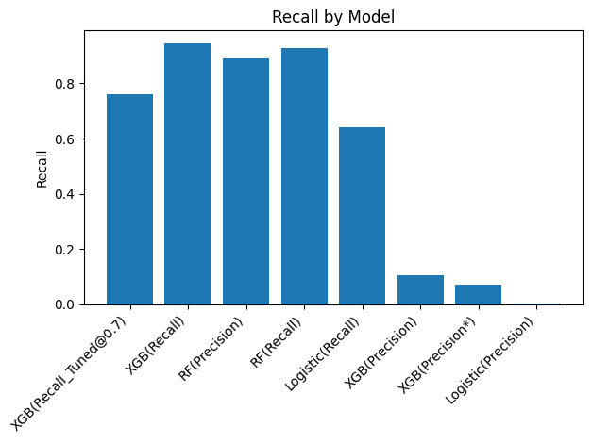
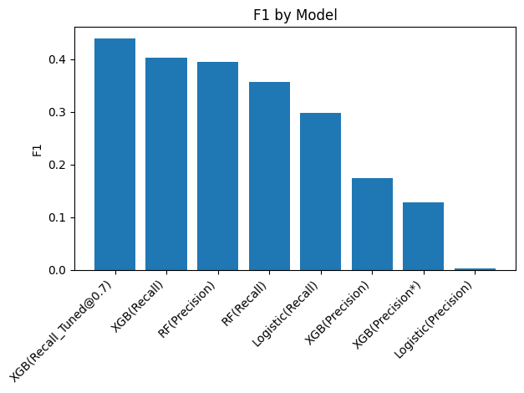
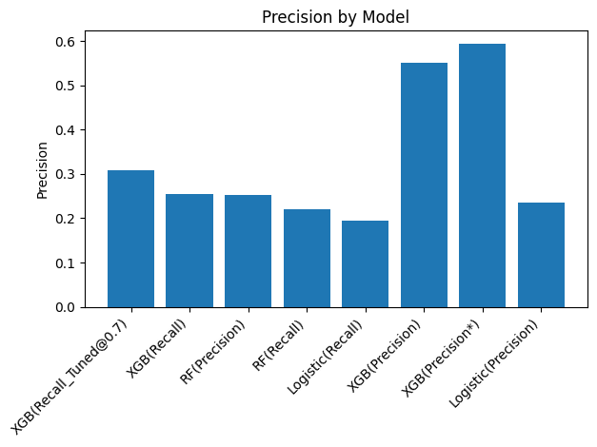
Evaluation Criteria

Slide 22

And the Winner is XGBoost
The best balance between performance & reliability
We don't miss any potential returnees. Recall = 0.76 -> XGBoost recognizes almost 8 out of 10 reactivatable customers
We are concentrating on the right customers and dont annoy wrong ones
XGBoost = Maximum impact with minimum wastage.
Good generalizability The model behaves consistently on unknown data (no overfitting)

Slide 23
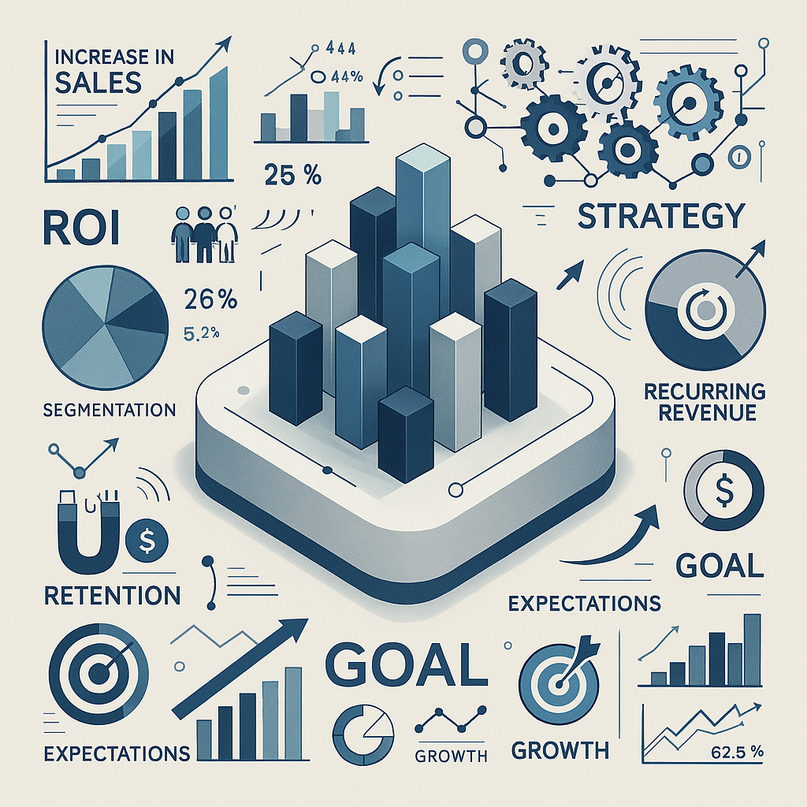
5. Business Insights

Slide 24
Business Insights
REVENUE GROWTH FROM SMART REACTIVATION
Higher sales by reactivating the right customers The model captures nearly all returnable customers – unlocking full revenue potential.
Recurring revenue through targeted reactivation Reactivated customers often make repeat purchases.→ The model helps unlock sustainable revenue streams without acquiring new customers.
Lower acquisition costs Reactivation is cheaper than acquiring new customers – the model focuses on cases where it’s most cost-efficient.
Notes:
Higher sales by reactivating the right customers
The model finds almost all customers who could come back.
No revenue potential is left untapped – we fully leverage the data
Recurring revenue through targeted reactivation
Reactivated customers often make repeat purchases.→ The model helps unlock sustainable revenue streams without acquiring new customers.
Lower acquisition costs
Winning back existing customers is significantly cheaper than acquiring new ones. → The model focuses on reactivation where it is both likely and cost-effective.

Slide 25
Business Insights
MORE EFFICIENT & TARGETED MARKETING
Clear targeting, less waste The model defines a precise reactivation group – campaigns focus only on those who matter.
Higher marketing ROI Resources are used where the chance of success is highest – with measurable return.
Smarter segmentation based on data We identify high-potential customer segments using model insights – improving targeting and outcomes.

Slide 26
Business Insights
CUSTOMER INSIGHTS & BONDING
Understanding customer motivation The model shows which factors drive reactivation – enabling more relevant offers and stronger engagement.
Data-backed decision-making The model reveals why a customer might return – supporting better strategic decisions.
Stronger long-term customer loyalty Reactivated customers can become loyal relationships – increasing their long-term value.
Notes:
Understanding customer motivation
The model reveals which factors lead to reactivation – (e.g. nr of purchases, economic potential)
→ This enables more relevant offers and better engagement.
Data-backed decision-making
Using explainability tools like SHAP, we understand why a customer is likely to return. → This supports strategic decisions and builds trust in the model's predictions.
Stronger long-term customer loyalty
Reactivated customers can be nurtured into loyal, high-value relationships. → This increases the Customer Lifetime Value (CLV).

Slide 27
THANK YOU FOR YOUR ATTENTION
Roberto Vanzetta
Helena Borges Daré
Ignacio Kreis
Jacopo Abete
Jasper von Pachelbel

Slide 28

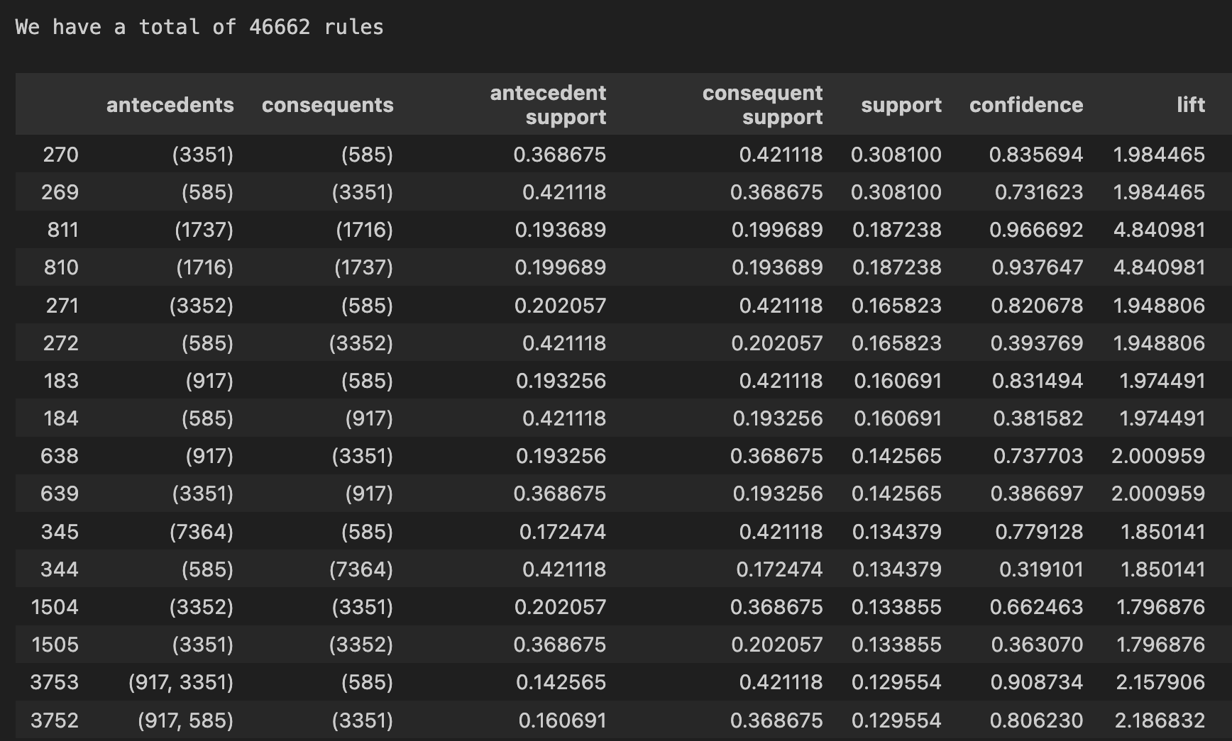
Using Association Rules¹ over 46k Purchasing Patterns were identified
DATASET ANALYSIS
KEY INSIGHTS
Strong Product Correlation between product x and product y
Common Rules (High Support) can be applied to a large part of customer base.
¹Method Used: Association Rules (Apriori Algorithm)
Notes:
Method Used: Association Rules (Apriori Algorithm)
We used a technique that’s often applied in retail: “People who buy this, also tend to buy that.”
Step-by-Step:
Grouped purchases per client.
Transformed that into a table of YES/NO (One-Hot Encoding)
Ran the Apriori Algorithm
Created rules like: "If a client buys item A and B, there’s a 90% chance they’ll also buy item C“
4. Sorted Rules by Strength
We focused on rules that are common and highly confident (they're true most of the time).

Slide 29



Association Rules reveal Valuable Insights about Inactive Customers
If a customer previously purchased a part of a common purchasing patter, then we can predict what they are likely interested in next.
Customers share behaviour patterns with currently active customers.
Conclusion:
If a customer’s past behaviour matches a strong rule, indicating a future purchase, they are more likely to respond to targeted reactivation campaigns featuring related products.
Notes:
Technical Justification (Brief)
We chose Apriori with One-Hot Encoding for its explainability
The algorithm provides clear, interpretable rules
Each rule is backed by metrics like confidence and lift, which we use to measure predictive strength

Slide 30


A Strong Purchasing Correlation was found for Items 3351 and 585
ITEMS 3351 & 585
RULE 1
A purchase of item 3351 also leads to a purchase of 585 :
83% Confidence
31% Support (percentage of customers the rule is true for)
1.98 Lift: the combination of items occurs almost twice as often as random combinations
Prediction of inactive customers’ likelihood to repurchase
¹Method Used: Association Rules (Apriori Algorithm)
Notes:
Strong product relationships — e.g., customers who bought product X are very likely to buy product Y.
Some rules are extremely confident (up to 96%) — meaning they’re very reliable.
Lift values > 1.5–4.8 show these aren't just random links — these are meaningful habits or needs.
Common rules (high support) mean we can apply these to a large part of the customer base.

Slide 31
